Slide 1
Interactive Terabytes with pbdR
Wei-Chen Chen, Drew Schmidt, and
George Ostrouchov
pbdR Core Team
http://r-pbd.org

Slide 2

Disclaimer
The findings and conclusions in this presentation have not been formally disseminated by the U.S. Department of Health & Human Services nor by the U.S. Department of Energy, and should not be construed to represent any determination or policy of University, Agency, Administration and National Laboratory.

Slide 3
Acknowledgement
Support:
This work was supported in part by the project ``Harnessing Scalable Libraries for Statistical Computing on Modern Architectures and Bringing Statistics to Large Scale Computing’’ funded by the National Science Foundation Division of Mathematical Sciences under Grant No. 1418195.
This work used resources supported by the National Science Foundation under Grant Number 1137097 and by the University of Tennessee through the Beacon Project.

Slide 4
Outlines
Two text based client/server applications
Demonstration of pbdR client/server
one pbdR client with one pbdR server
pbdZMQ + remoter (+ getPass + sodium)
Introduction
Implementation for HPC
Demonstration of pbdR cluster
one pbdR client with pbdR cluster in SPMD
pbdZMQ + remoter + pbdCS (+ getPass + sodium) + pbdR’s packages
Discussion

Slide 5
Two text based client/server applications

Slide 6
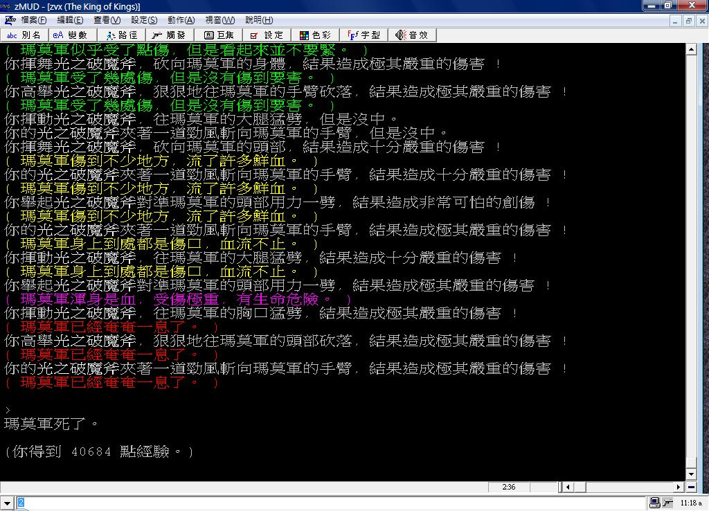
MMORPG MUD
A client/server game (King Of Kings, 1996)
(https://zh.wikipedia.org/wiki/File:KK_MUD.jpg)

Slide 7
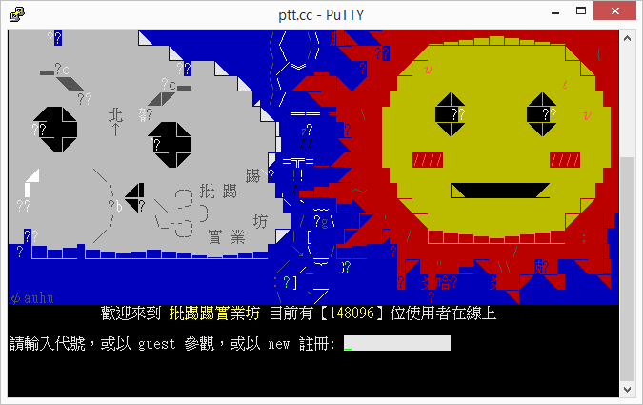
Bulletin Board System
A client/server BBS (telnet://ptt.cc, 1995)
over 150,000 users online during peak hours

Slide 8
Demonstration of pbdR client/server https://github.com/snoweye/user2016.demo

Slide 9
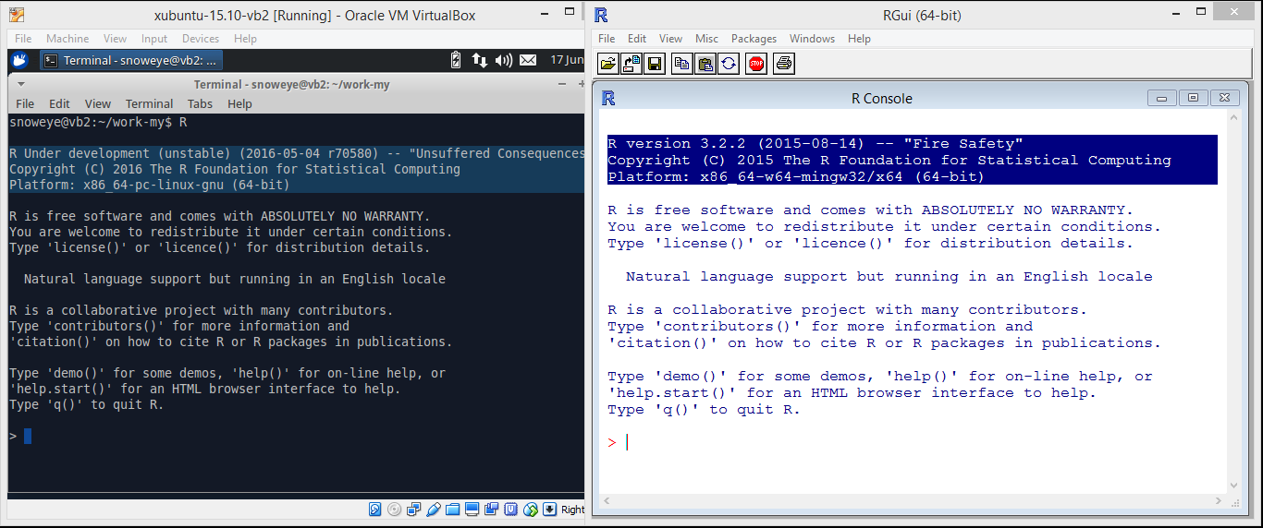
pbdZMQ + remoter
https://github.com/snoweye/user2016.demo
server/remote
guest OS: Xubuntu-15.10
R-devel r70580 (64-bit)
client/local
host OS: Microsoft Windows 8
R 3.2.2 (64-bit)

Slide 10
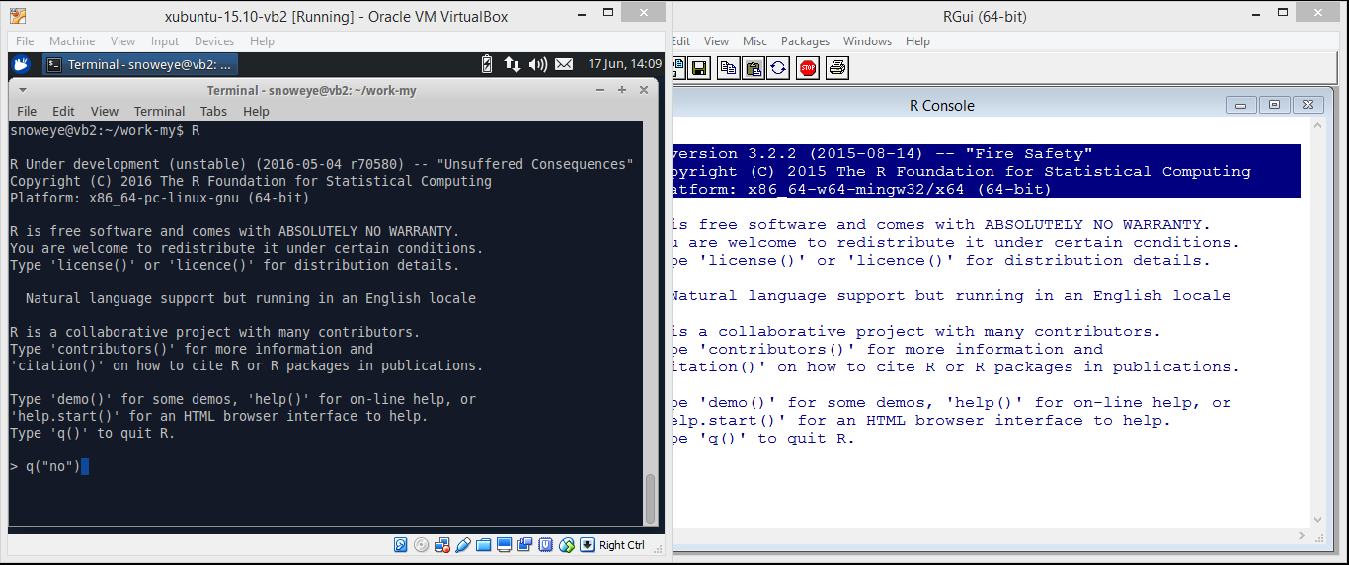
pbdZMQ + remoter
https://github.com/snoweye/user2016.demo
server/remote
just normally quit R
go back to command line
client/local
do nothing

Slide 11

pbdZMQ + remoter
https://github.com/snoweye/user2016.demo
server/remote
use `ifconfig` to obtain ip address
client/local
do nothing

Slide 12
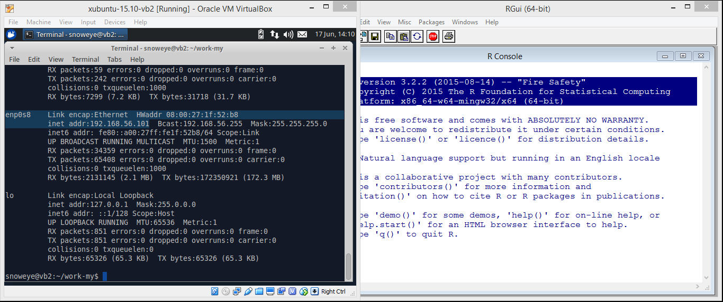
pbdZMQ + remoter
https://github.com/snoweye/user2016.demo
server/remote
guest OS has a host-only adapter
ip: 192.168.56.101
client/local
do nothing

Slide 13

pbdZMQ + remoter
https://github.com/snoweye/user2016.demo
server/remote
launch remote R server
with password protection
password: pbdr
client/local
do nothing

Slide 14
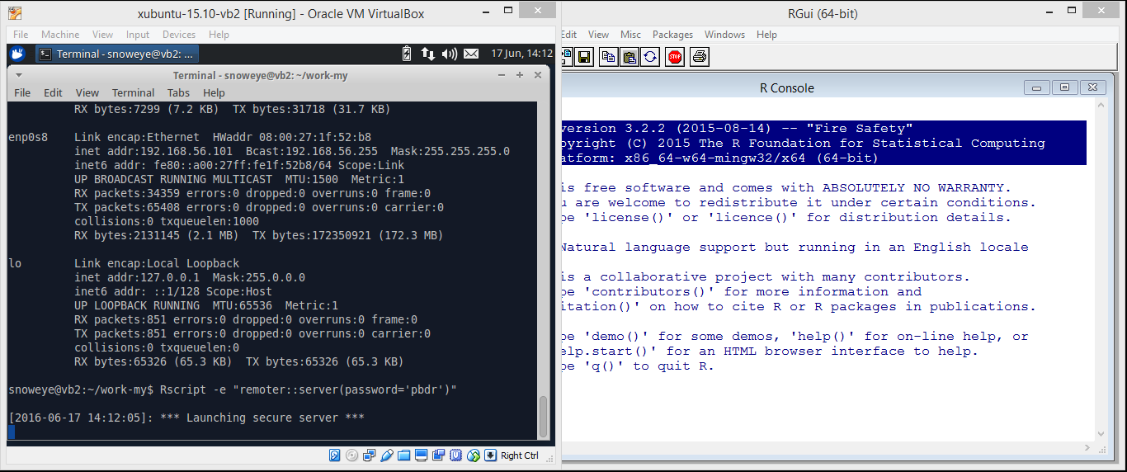
pbdZMQ + remoter
https://github.com/snoweye/user2016.demo
server/remote
remoter server is on
client/local
do nothing

Slide 15
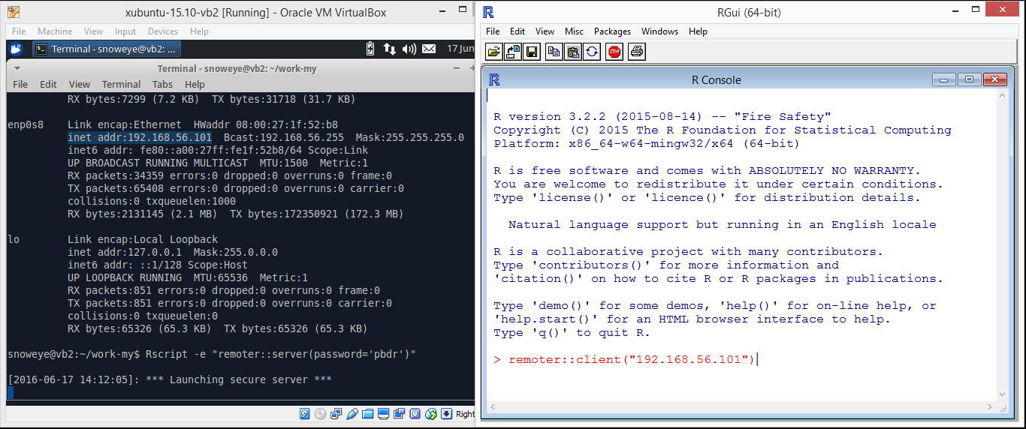
pbdZMQ + remoter
https://github.com/snoweye/user2016.demo
server/remote
server is waiting
client/local
connect to server

Slide 16
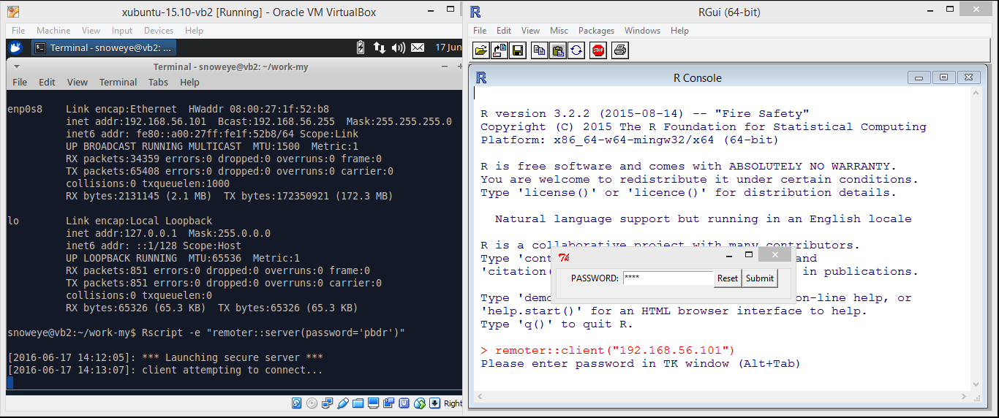
pbdZMQ + remoter
https://github.com/snoweye/user2016.demo
server/remote
remoter server responses requests
client/local
enter password (masked)

Slide 17
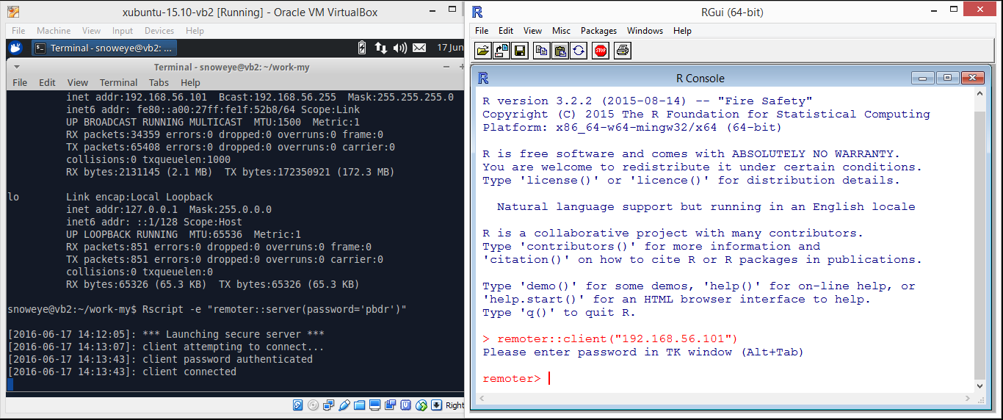
pbdZMQ + remoter
https://github.com/snoweye/user2016.demo
server/remote
check the password
connect the client
client/local
start remote R
connect to the server
everything is on the sever from now on

Slide 18
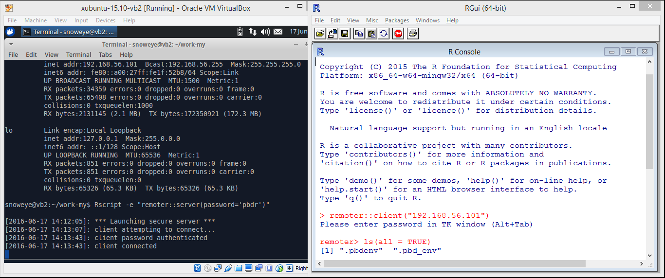
pbdZMQ + remoter
https://github.com/snoweye/user2016.demo
server/remote
executing client’s commands
client/local
check what is on server

Slide 19
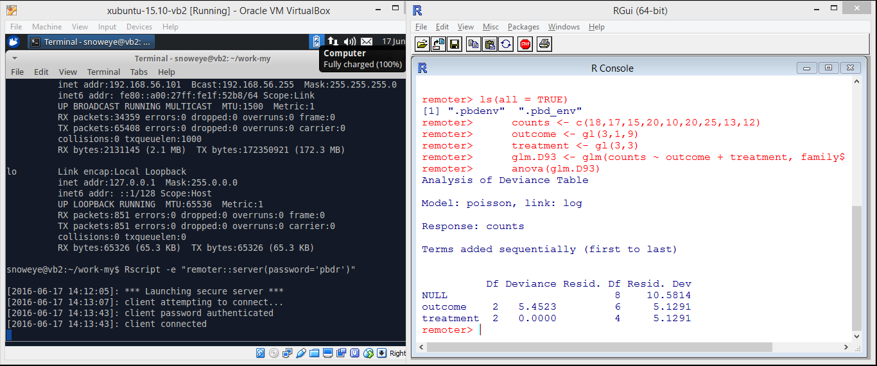
pbdZMQ + remoter
https://github.com/snoweye/user2016.demo
server/remote
receive, execute, and return client’s commands
log message is disabled
client/local
run `stats::glm()` example taken from `help(“glm”)`
run `stats::anova()` on the GLM model fit

Slide 20
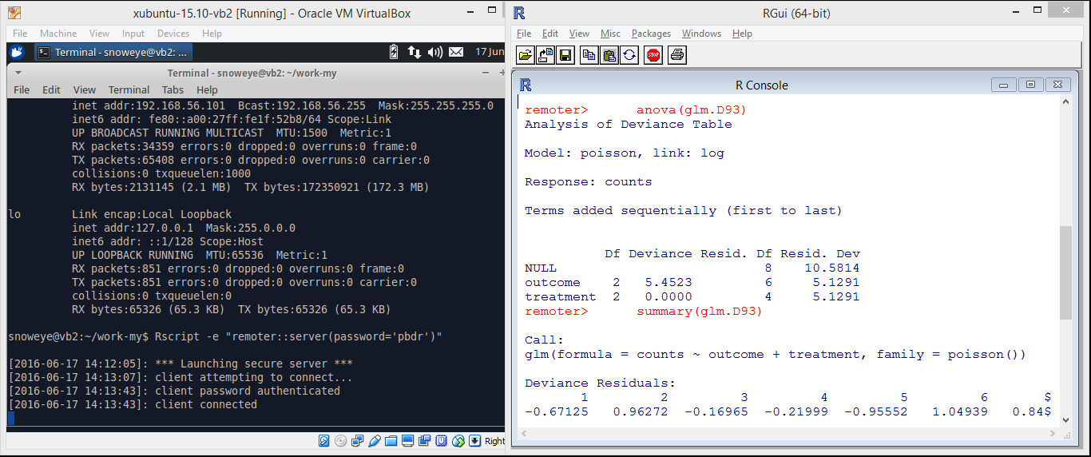
pbdZMQ + remoter
https://github.com/snoweye/user2016.demo
server/remote
receive, execute, and return client’s commands
log message is disabled
client/local
run `base::summary()` on the GLM model fit

Slide 21
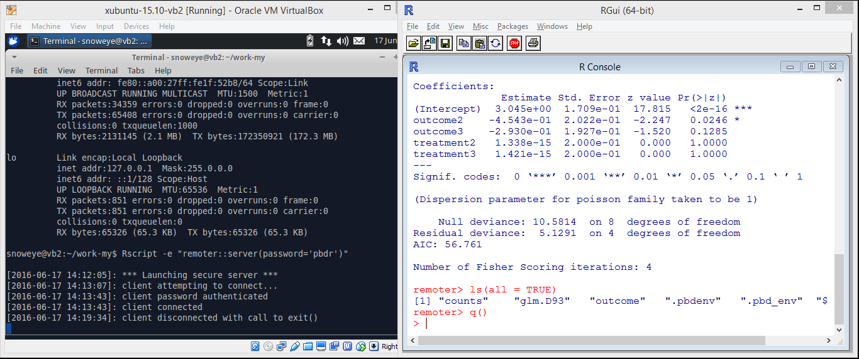
pbdZMQ + remoter
https://github.com/snoweye/user2016.demo
server/remote
disconnect the client
remoter server is still alive
client/local
check what are on server
done and quit, really!

Slide 22
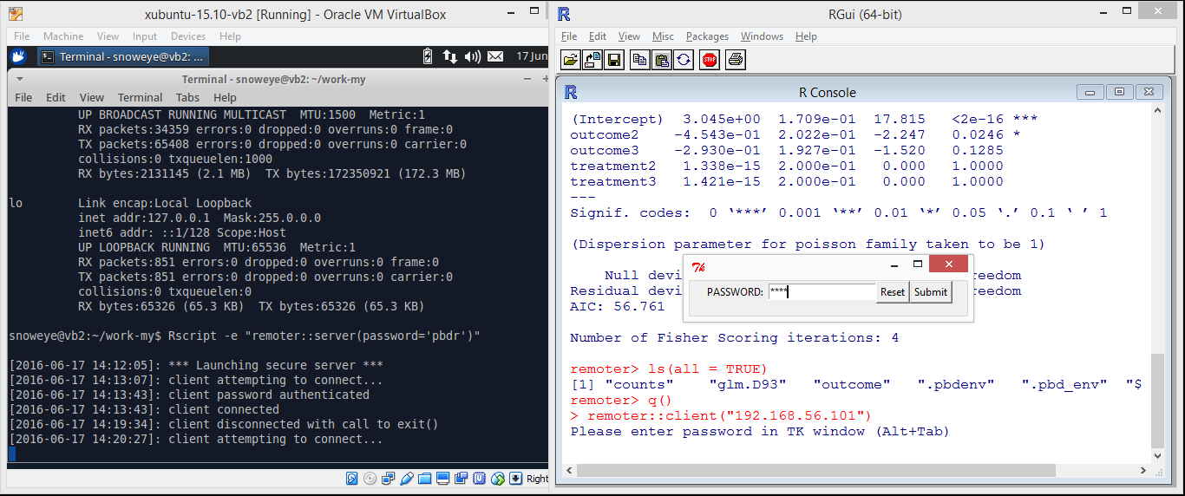
pbdZMQ + remoter
https://github.com/snoweye/user2016.demo
server/remote
the other client coming in
client/local
how about reconnect again?

Slide 23
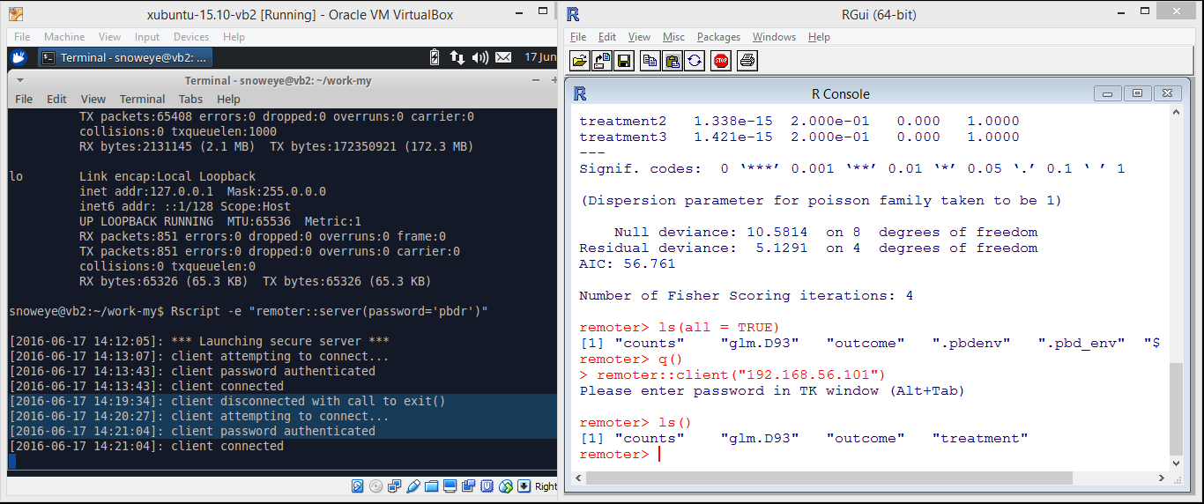
pbdZMQ + remoter
https://github.com/snoweye/user2016.demo
server/remote
server is on
the client is reconnected
client/local
check if data are still there

Slide 24
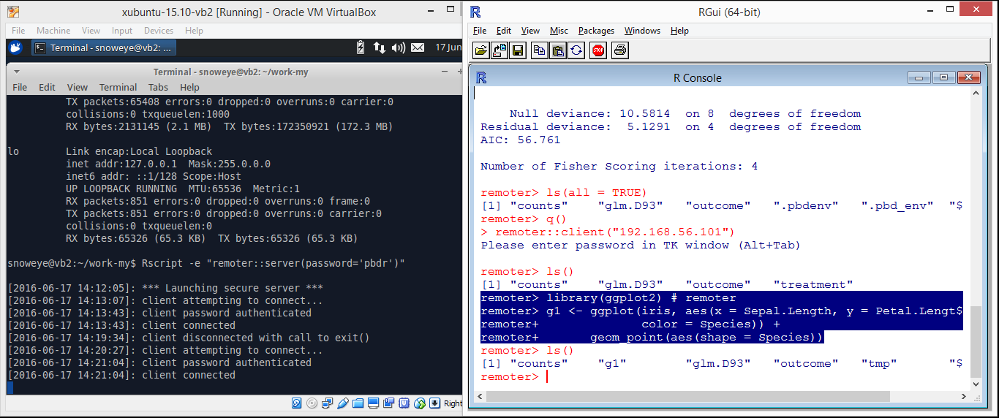
pbdZMQ + remoter
https://github.com/snoweye/user2016.demo
server/remote
receive, execute, and return client’s commands
log message is disabled
client/local
how about to have some plots?
load `ggplot2`
run an `iris` example

Slide 25
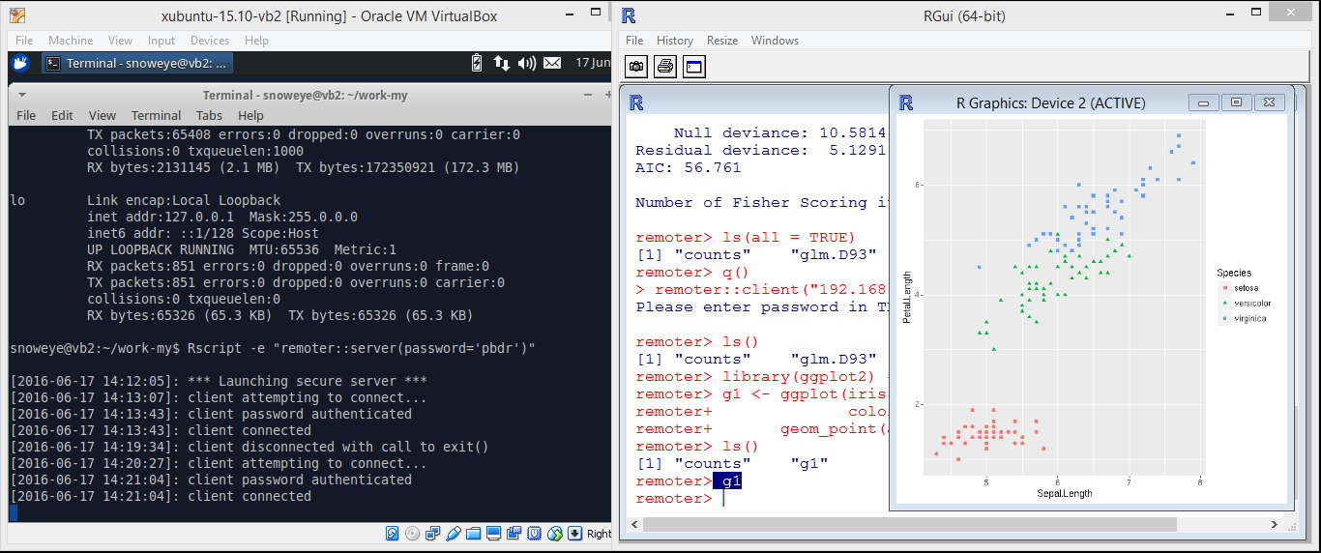
pbdZMQ + remoter
https://github.com/snoweye/user2016.demo
server/remote
receive, execute, and return client’s commands
log message is disabled
client/local
data are on server
only image is got from the server
print the image locally

Slide 26
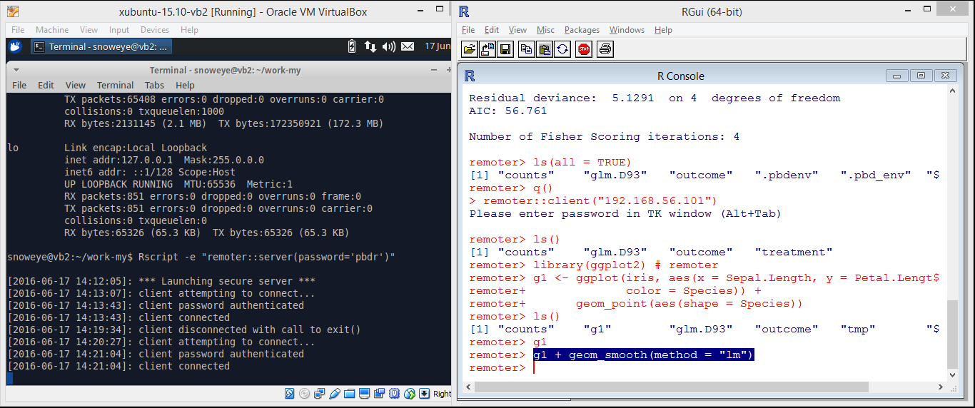
pbdZMQ + remoter
https://github.com/snoweye/user2016.demo
server/remote
receive, execute, and return client’s commands
log message is disabled
client/local
how about directly update the `ggplot` object?

Slide 27
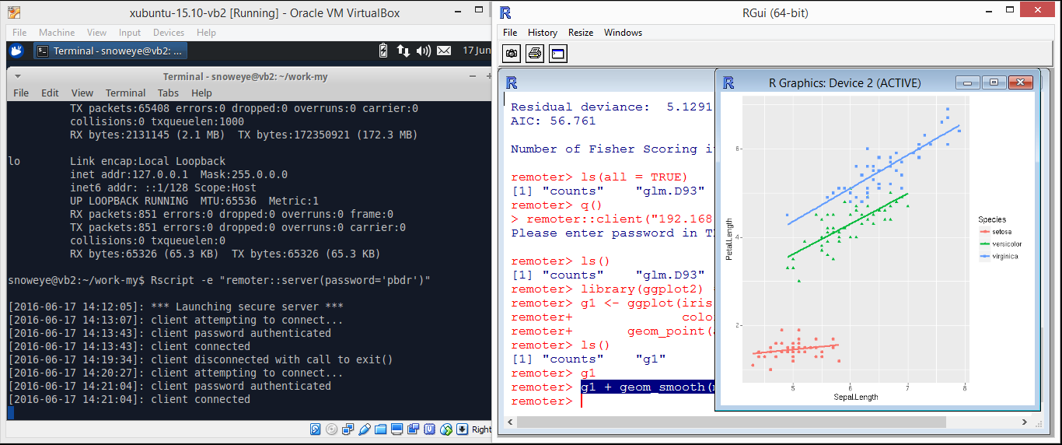
pbdZMQ + remoter
https://github.com/snoweye/user2016.demo
server/remote
receive, execute, and return client’s commands
log message is disabled
client/local
yes, regression lines are added

Slide 28
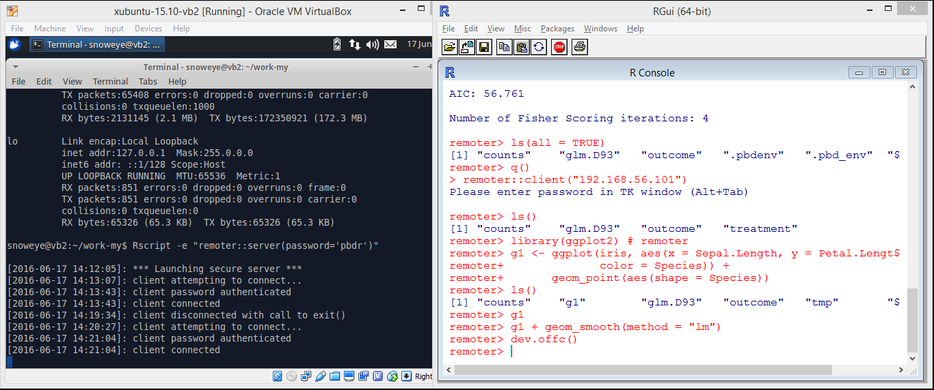
pbdZMQ + remoter
https://github.com/snoweye/user2016.demo
server/remote
receive, execute, and return client’s commands
log message is disabled
client/local
close the remoter graphic device via `dev.offc()` locally

Slide 29
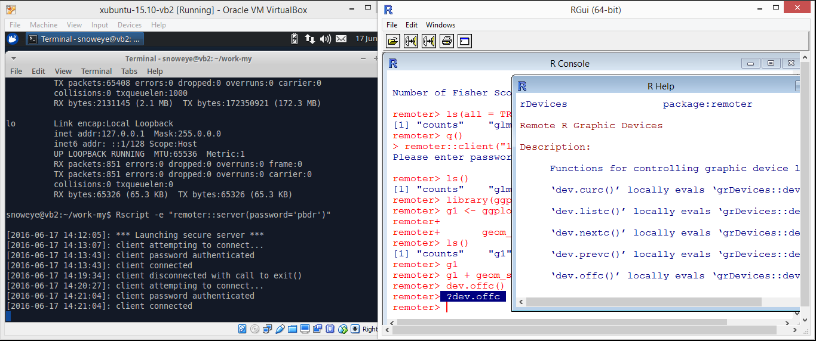
pbdZMQ + remoter
https://github.com/snoweye/user2016.demo
server/remote
receive, execute, and return client’s commands
log message is disabled
client/local
what is `dev.offc()`?
this help page is sent from server!!!

Slide 30
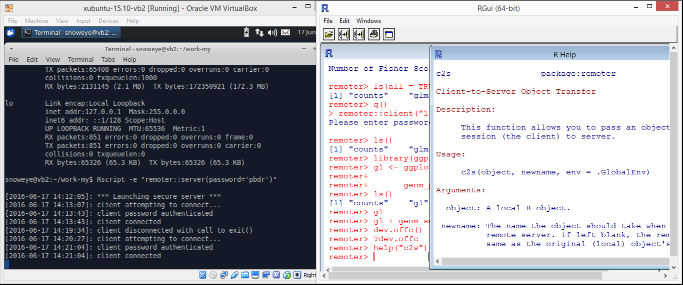
pbdZMQ + remoter
https://github.com/snoweye/user2016.demo
server/remote
receive, execute, and return client’s commands
log message is disabled
client/local
how about copy a local R object to the server/remote?
this help page is also sent from server

Slide 31
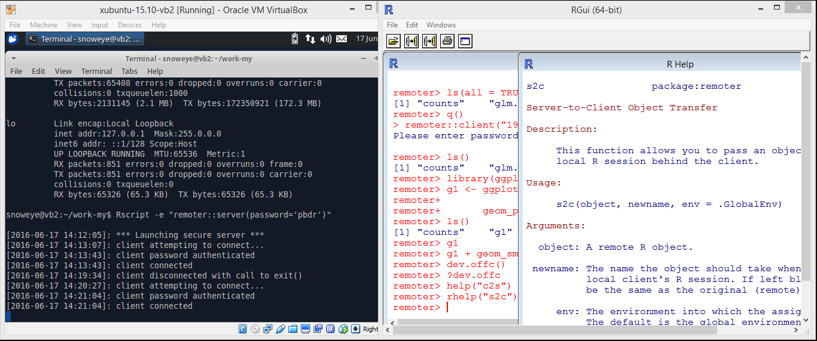
pbdZMQ + remoter
https://github.com/snoweye/user2016.demo
server/remote
receive, execute, and return client’s commands
log message is disabled
client/local
how about copy a remote R object to the client/local?
this help page is still sent from server

Slide 32
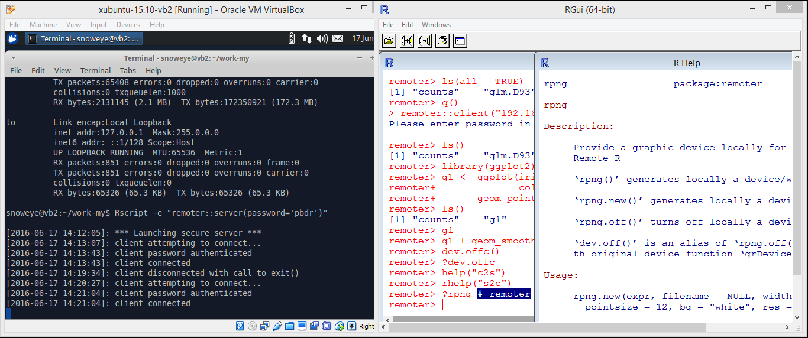
pbdZMQ + remoter
https://github.com/snoweye/user2016.demo
server/remote
receive, execute, and return client’s commands
log message is disabled
client/local
how does the remoter graphic device work?
up/down keys to get history commands

Slide 33
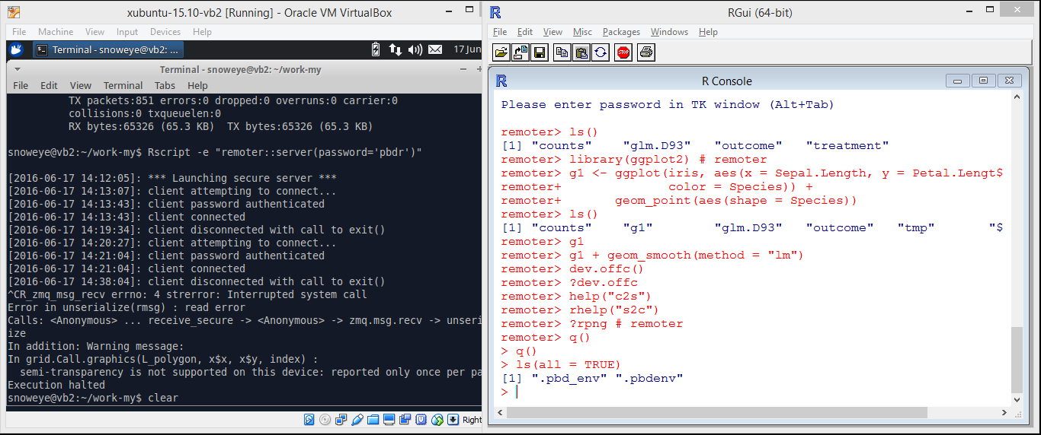
pbdZMQ + remoter
https://github.com/snoweye/user2016.demo
server/remote
ctrl+c to kill the server
client/local
nothing is at local really …
use `q()` to quit or `shutdown()` to kill the server

Slide 34
Introduction

Slide 35
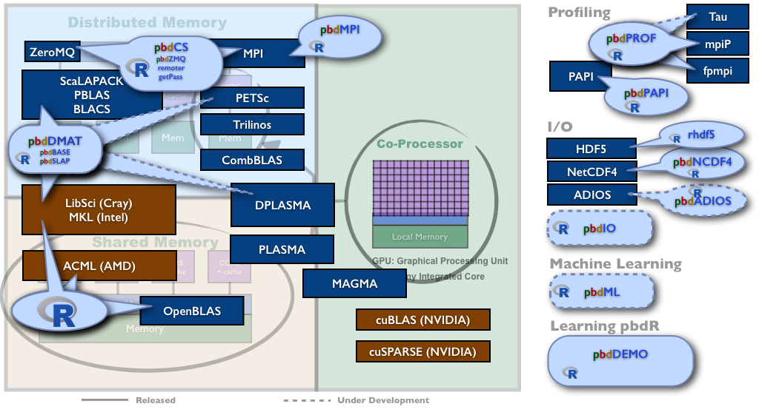
pbdR Project Brings HPC to R
Notes:
The pbdR project is about bringing HPC research to R, adding what is missing, and making it all work together seamlessly.
There are components for computing, for I/O, for profiling, and for machine learning.
In this talk we focus on the client/server access to all the HPC power. How to control a thousand cooperating R sessions from one R session.

Slide 36
Advantages of pbdR Client/Server
No need to
setup X11 nor forwarding
know httpd nor html nor htt* whatever
know js nor json nor java nor j* whatever
open any web browser
worry about how to send or receive commands, different data, files, outputs, figures, or help
worry if a client/local/laptop has enough memory

Slide 37
Limitations of pbdR Client/Server
Too simple, you must speak R …
Too bad, you still need to understand
Single Program Multiple Data
(SPMD) …

Slide 38
Some Good News
Allow to
run most R packages (no change nor implementation)
run on major OSs (including Solaris and Windows)
run across different systems (as long as the same bits)
plugin out-of-core or distributed backend to servers
ff, bigmenory, sparkR, ddR, hadoop, …
database, sql, dbi, …
web services
mask password
encrypt communication (good data policy)
interact by multiple users (like MUD or BBS)

Slide 39
Designs for Terabytes Interactivity
pbdR Client/Server
Client/Server Framework
Communication
pbdZMQ
pbdCS
Computation Backend
remoter
pbdDMAT
Security
sodium
getPass
pbdMPI
Reference: Schmidt, Chen, and Ostrouchov (XSEDE2016)

Slide 40
pbdR Client/Server Frameworks
One pbdR client and one pbdR server
pbdZMQ + remoter (+ getPass + sodium)
Note sodium is not part of pbdR, but greatly improve security of communication
One pbdR client and pbdR cluster in SPMD
pbdZMQ + remoter + pbdCS + pbdR’s packages

Slide 41
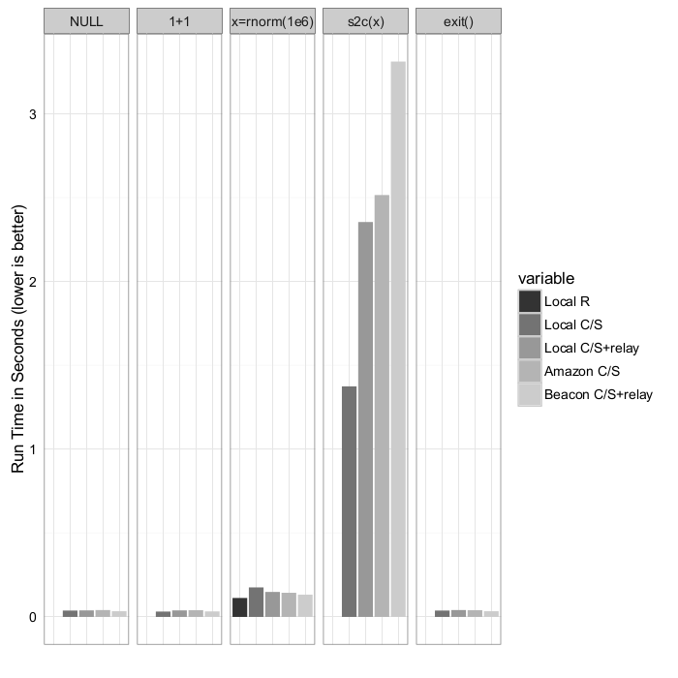
Benchmark
Wall-clock time measurement of some simple operations, demonstrating the costs. Reference: Schmidt, Chen, and Ostrouchov (XSEDE2016)

Slide 42
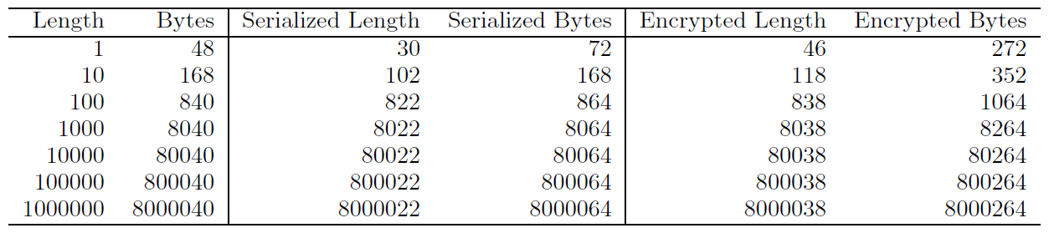
Benchmark
The overhead of serializing and additionally encrypting a vector of double precision numbers of given length. Reference: Schmidt, Chen, and Ostrouchov (XSEDE2016)

Slide 43
Implementation for HPC

Slide 44
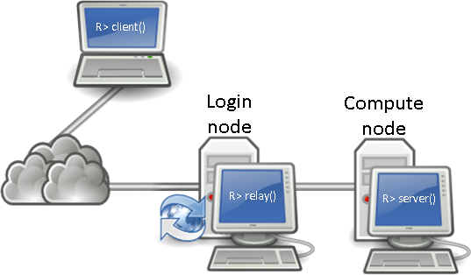
pbdCS on Supercomputer
High Performance Computing (HPC) Resource
Supercomputer (XSEDE)
Google Compute Engine
Amazon EC2
Homemade clusters
Mobile Device
Reference: Schmidt, Chen, and Ostrouchov (XSEDE2016)

Slide 45
Main Concepts
Everything is on server (remote)
Global and distributed by default
Nothing is in client (local) except necessary communication and interaction
SPMD batch scripts can be run or sourced interactively in client/server framework
``Distributed Read, Compute, Statistics, and Output ...''

Slide 46
A SPMD Example
Input: allreduce(1)
MPI Rank 0
Client
“allreduce(1)”
Request
Reply
Push
Return: 3
3
allreduce(1)
“allreduce(1)”
MPI Rank 1
“allreduce(1)”
Input: allreduce(1)
Client transmits message to server
Messaging server broadcasts message to other SPMD servers
SPMD servers execute command
Messaging server returns result to client
Output: 3
Pull
allreduce(1)
MPI Rank 2
Pull
Reference: Schmidt, Chen, and Ostrouchov (XSEDE2016)
allreduce(1)

Slide 47
Demonstration of pbdR cluster https://github.com/snoweye/user2016.demo

Slide 48
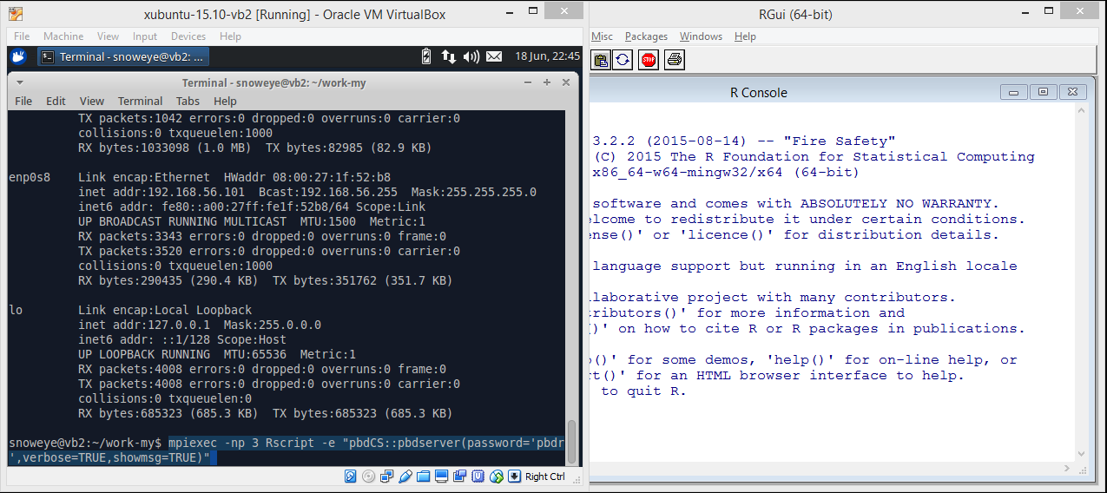
pbdCS + pbdMPI + pbdDMAT
https://github.com/snoweye/user2016.demo
server/remote/MPI clusters
run MPI in 3 jobs
each job runs a Rscript
each Rscript has a `pbdCS::pbdserver()`
client/local
do nothing

Slide 49
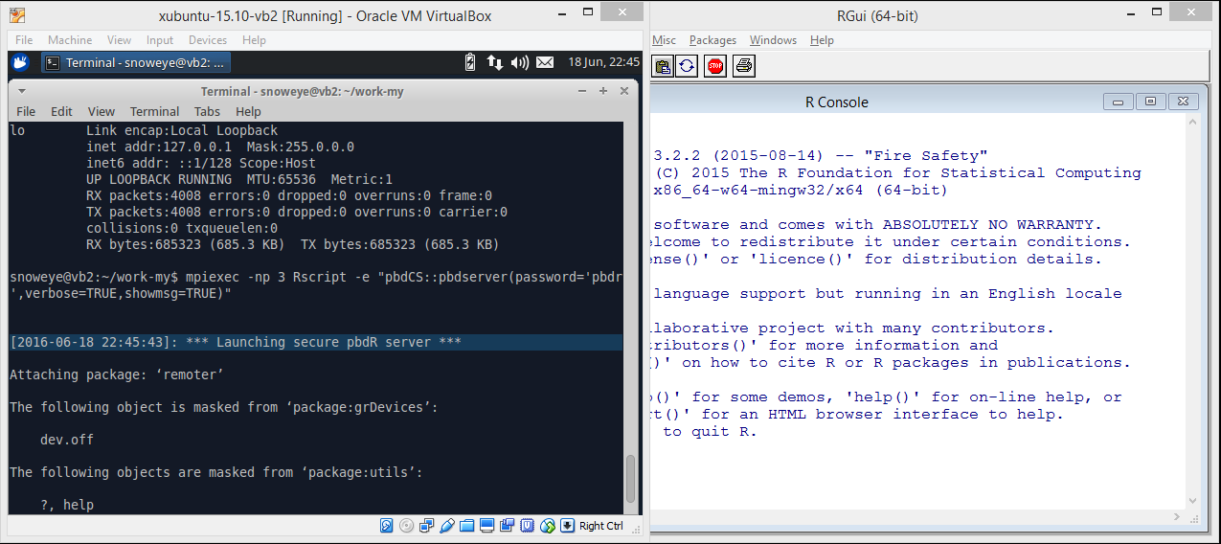
pbdCS + pbdMPI + pbdDMAT
https://github.com/snoweye/user2016.demo
server/remote/MPI clusters
server is on
with messages
client/local
do nothing

Slide 50
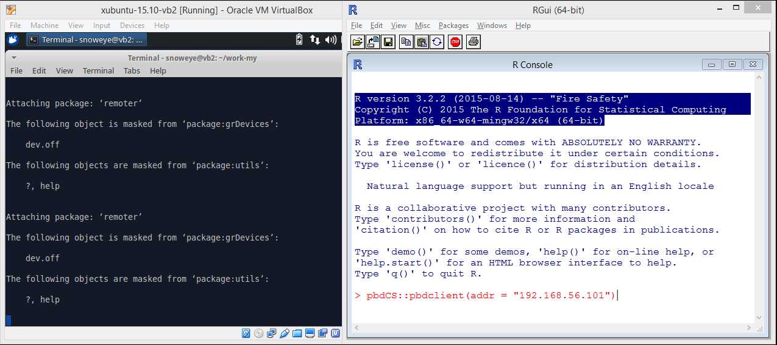
pbdCS + pbdMPI + pbdDMAT
https://github.com/snoweye/user2016.demo
server/remote/MPI clusters
wait for client
client/local
launch a `pbdCS::pbdclient()`

Slide 51
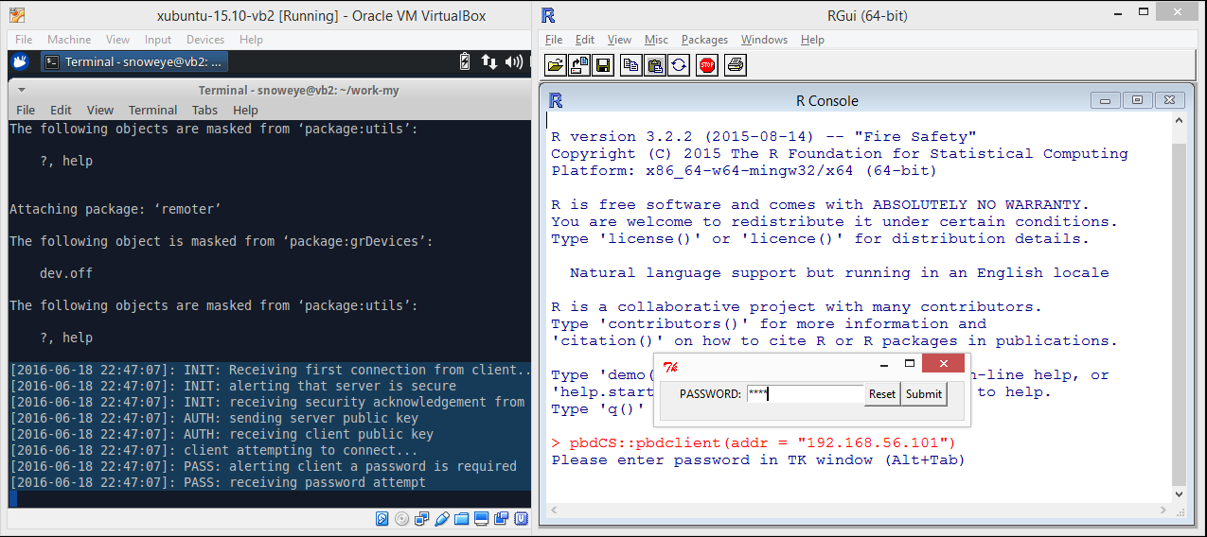
pbdCS + pbdMPI + pbdDMAT
https://github.com/snoweye/user2016.demo
server/remote/MPI clusters
wait for password
client/local
enter password

Slide 52
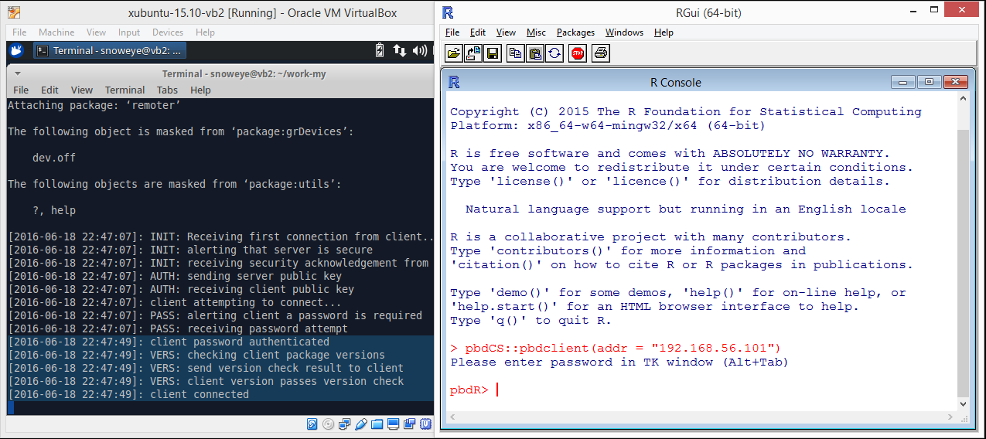
pbdCS + pbdMPI + pbdDMAT
https://github.com/snoweye/user2016.demo
server/remote/MPI clusters
check password
client/local
connect to server

Slide 53
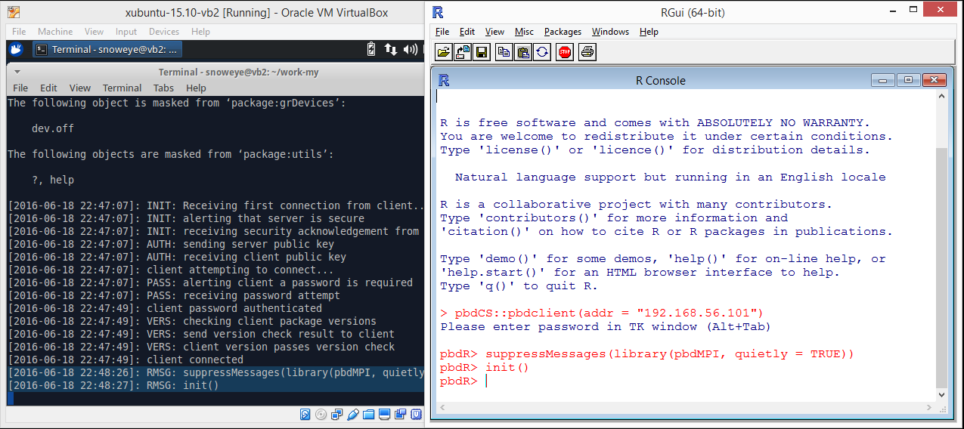
pbdCS + pbdMPI + pbdDMAT
https://github.com/snoweye/user2016.demo
server/remote/MPI clusters
load pbdMPI
initial MPI communicator
see pbdMPI vignette
client/local
ask server to load pbdMPI
ask server to initial MPI communicator

Slide 54
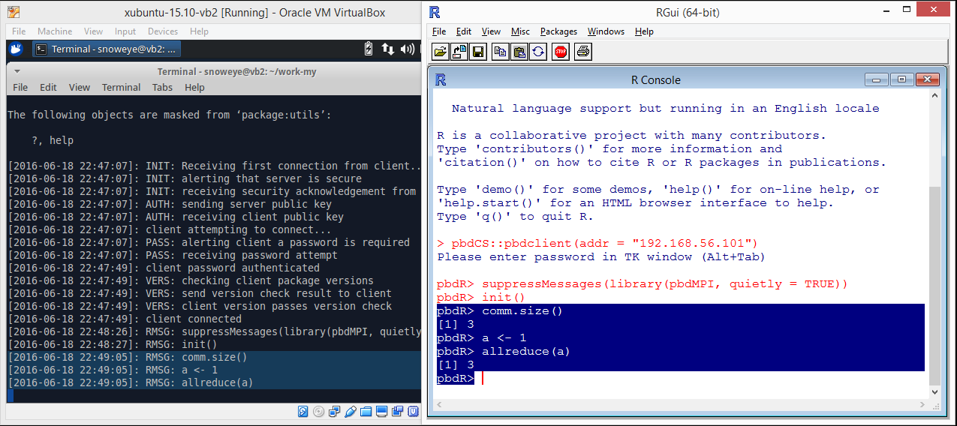
pbdCS + pbdMPI + pbdDMAT
https://github.com/snoweye/user2016.demo
server/remote/MPI clusters
receive commands from client
client/local
check comm size (3 ranks)
do a default `allreduce()` to sum over all ranks (every rank has `a=3`)

Slide 55
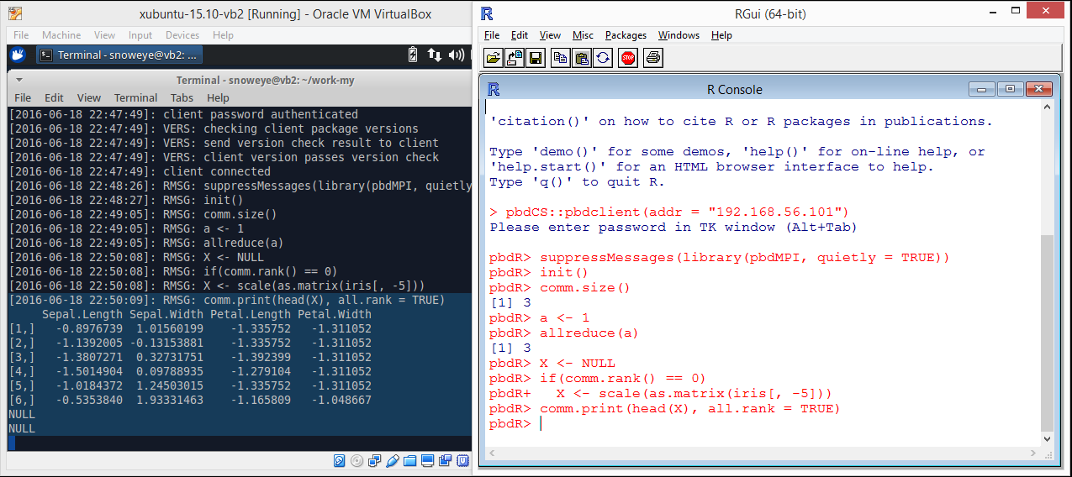
pbdCS + pbdMPI + pbdDMAT
https://github.com/snoweye/user2016.demo
server/remote/MPI clusters
only rank 0 has `iris`
client/local
standardized `iris
`comm.print()` prints to server as behave in batch mode

Slide 56
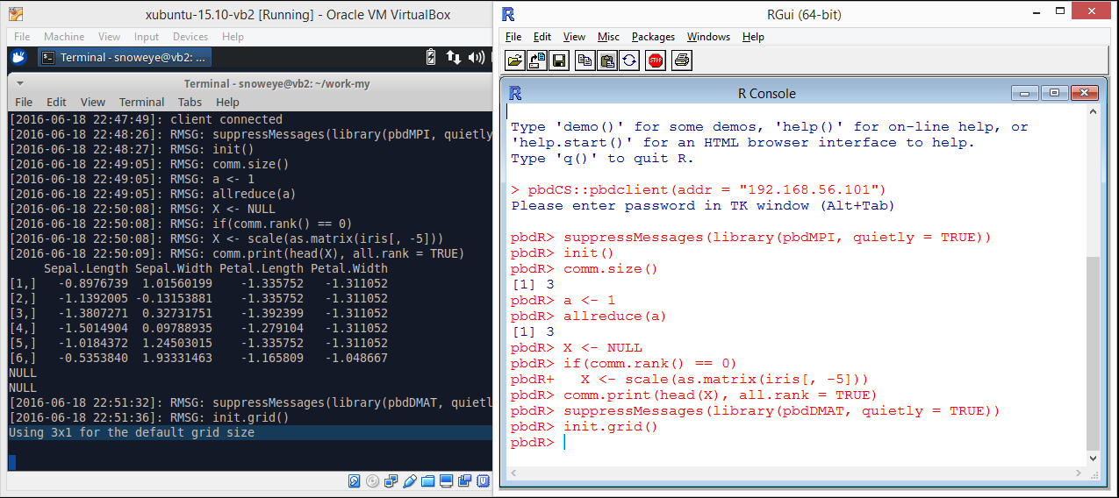
pbdCS + pbdMPI + pbdDMAT
https://github.com/snoweye/user2016.demo
server/remote/MPI clusters
3x1 grid is formed
client/local
load `pbdDMAT`
initial grid for block-cyclic
see pbdDEMO vignette

Slide 57
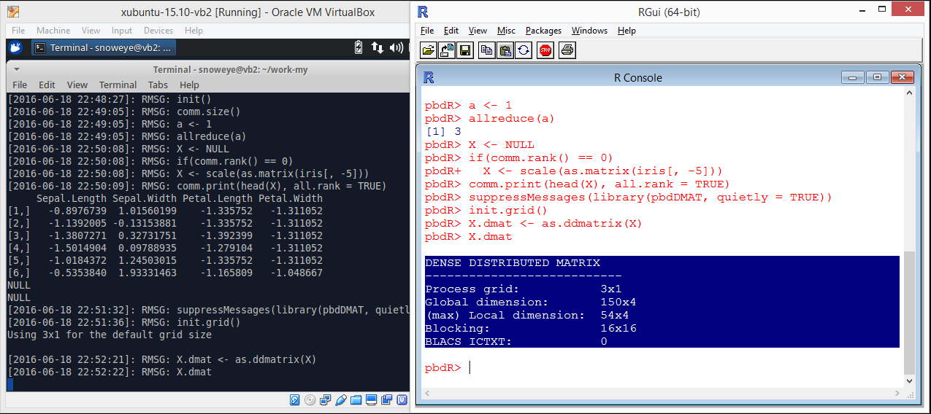
pbdCS + pbdMPI + pbdDMAT
https://github.com/snoweye/user2016.demo
server/remote/MPI clusters
receive client commands
client/local
convert data to a `ddmatrix`
`print.ddmatrix()` casts summary to local

Slide 58
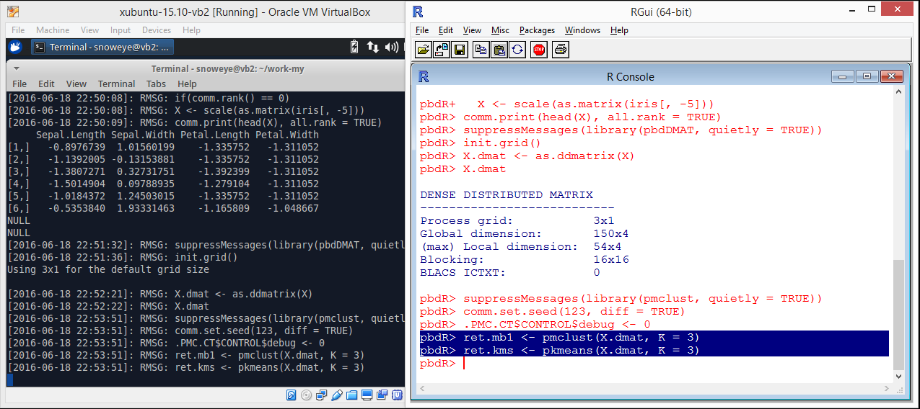
pbdCS + pbdMPI + pbdDMAT
https://github.com/snoweye/user2016.demo
server/remote/MPI clusters
receive more client commands
client/local
load `pmclust` for clustering distributed data
see Chen, et.al. (2013) Technometrics

Slide 59
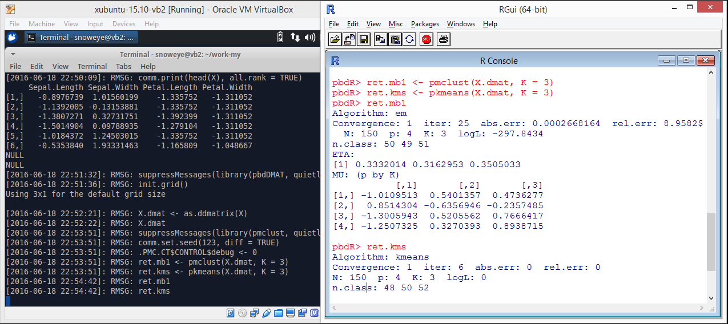
pbdCS + pbdMPI + pbdDMAT
https://github.com/snoweye/user2016.demo
server/remote/MPI clusters
receive more client commands
client/local
summary clustering results

Slide 60
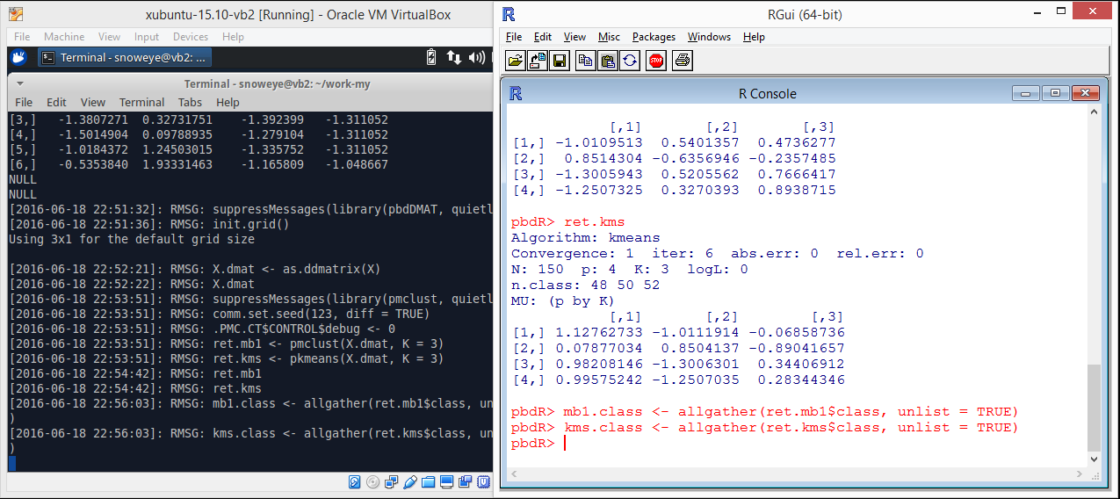
pbdCS + pbdMPI + pbdDMAT
https://github.com/snoweye/user2016.demo
server/remote/MPI clusters
receive more client commands
client/local
`allgather()` all clustering ids from all ranks to every ranks
`gather()` should be faster

Slide 61
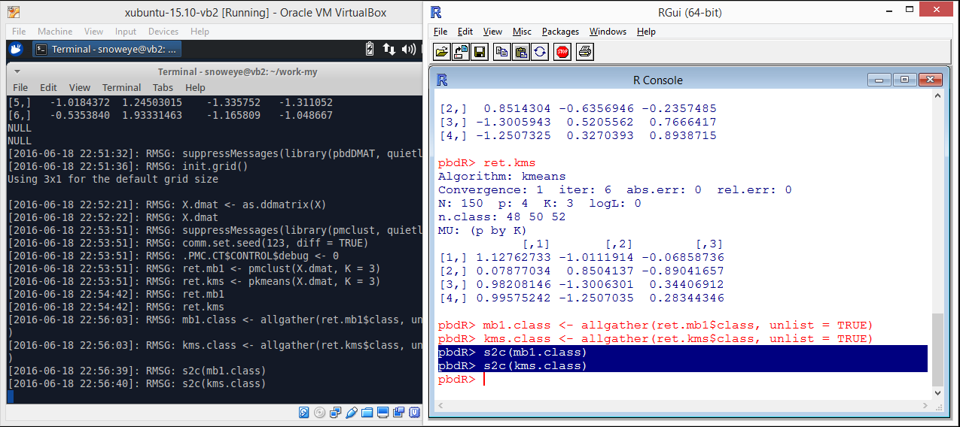
pbdCS + pbdMPI + pbdDMAT
https://github.com/snoweye/user2016.demo
server/remote/MPI clusters
receive more client commands
client/local
copy clustering ids from server (rank 0) to client

Slide 62
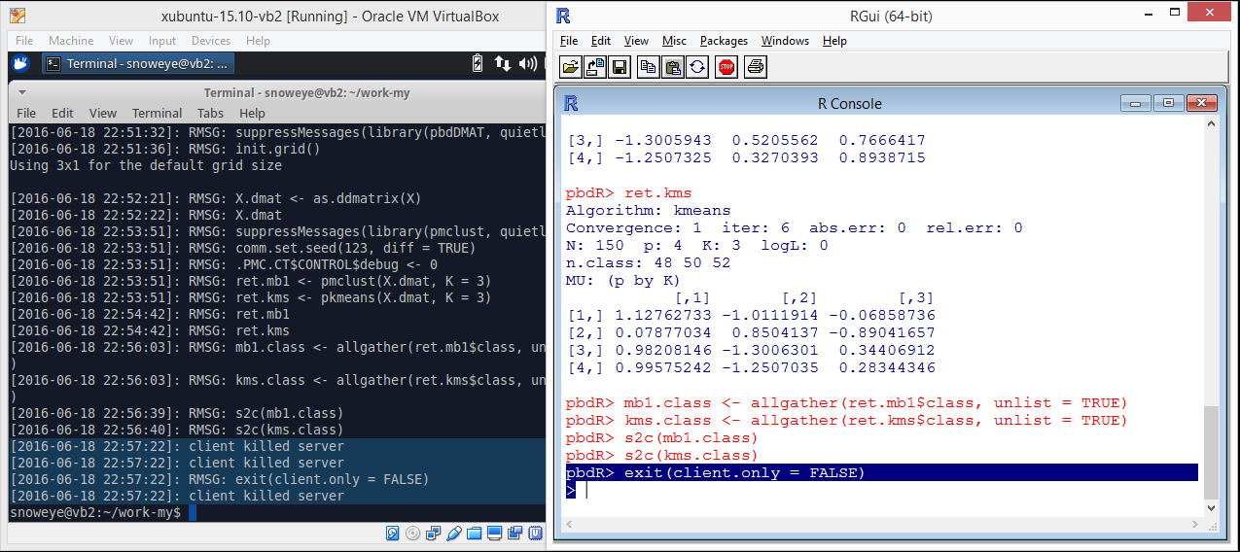
pbdCS + pbdMPI + pbdDMAT
https://github.com/snoweye/user2016.demo
server/remote/MPI clusters
kill server
kill all MPI jobs as well
client/local
exit and kill server and MPI jobs
release resources for other users

Slide 63
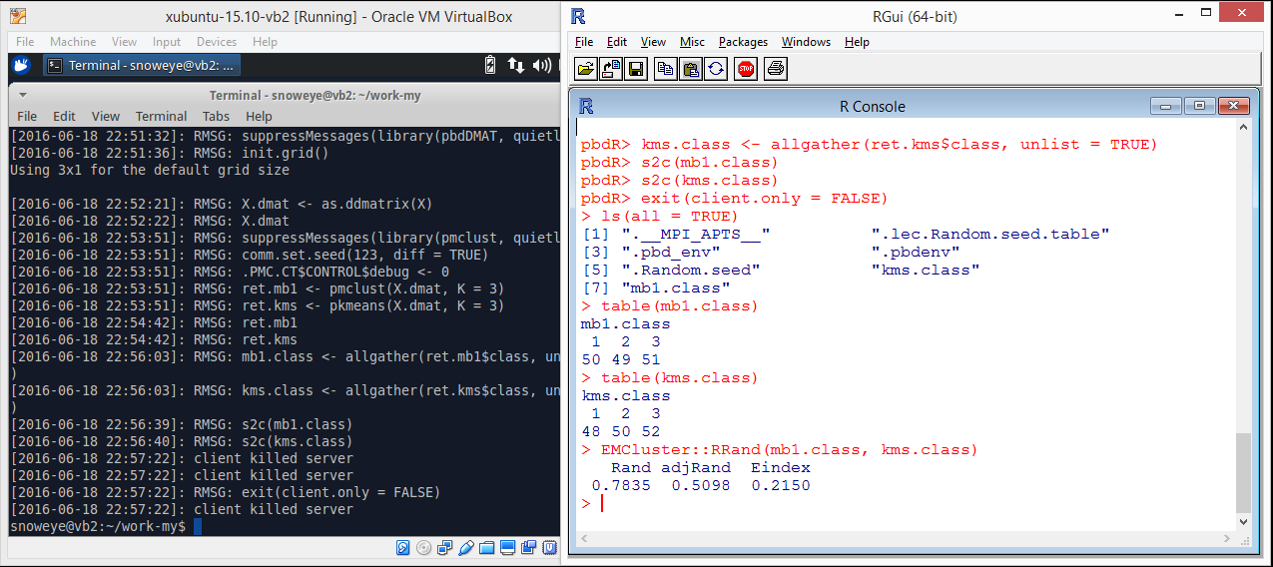
pbdCS + pbdMPI + pbdDMAT
https://github.com/snoweye/user2016.demo
server/remote/MPI clusters
done
client/local
check consistence between model-based results and k-means results

Slide 64
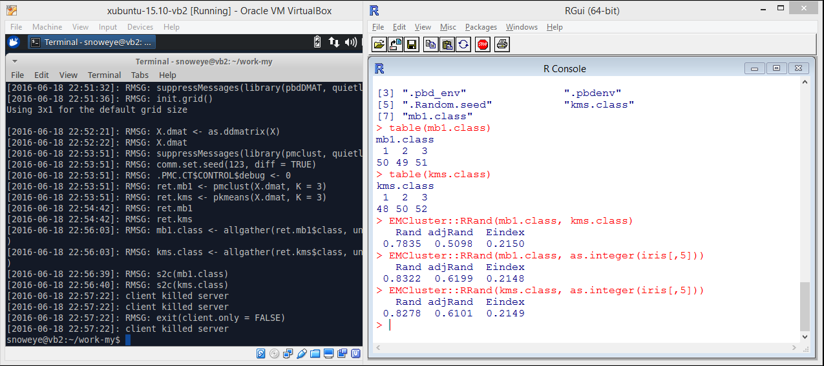
pbdCS + pbdMPI + pbdDMAT
https://github.com/snoweye/user2016.demo
server/remote/MPI clusters
done
client/local
check consistence with true ids of `iris`

Slide 65
75 GB Benchmark on 512 cores
> library(pbdCS)
> pbdclient()
pbdR> library(memuse)
pbdR> howbig(1e7, 1e3)
74.506 GiB
pbdR> comm.size()
[1] 512
pbdR> library(pbdDMAT)
pbdR> init.grid()
pbdR> system.time(x <- ddmatrix("rnorm", 1e7, 1e3))
user system elapsed
6.034 0.022 6.058
pbdR> system.time(xtx <- t(x) %*% x)
user system elapsed
182.744 0.158 182.963
pbdR> system.time(xtx <- crossprod(x))
user system elapsed
11.056 0.551 11.613
pbdR> system.time(x.pca <- prcomp(x))
user system elapsed
152.899 1.419 154.422

Slide 66
75 GB Benchmark on 512 cores
pbdR> library(pbdML)
pbdR> system.time(x.pca <- rpca(x, k=5))
user system elapsed
15.177 0.673 15.922
pbdR> x
DENSE DISTRIBUTED MATRIX
---------------------------
Process grid: 32x16
Global dimension: 10000000x1000
(max) Local dimension: 312512x64
Blocking: 16x16
BLACS ICTXT: 0
pbdR> xtx
DENSE DISTRIBUTED MATRIX
---------------------------
Process grid: 32x16
Global dimension: 1000x1000
(max) Local dimension: 32x64
Blocking: 16x16
BLACS ICTXT: 0
pbdR> names(x.pca)
[1] "sdev" "rotation" "center" "scale" "x"
pbdR> x.pca$sdev
[1] 1.001280 1.000767 1.000654 1.000422 1.000305
pbdR> shutdown()

Slide 67
Discussion

Slide 68
Other Interactive Frameworks
R
rmote (https://github.com/cloudyr/rmote)
shiny
parallel, snow, Rmpi
Python & Jupyter
IRkernel (https://github.com/IRkernel/IRkernel) depending on pbdZMQ as well

Slide 69
Future Directions
could be your application and dream
RBigData@gmail.com
https://github.com/RBigData

Slide 70
References
Schmidt, D., Chen, W.-C. and Ostrouchov, G. (2016), ``Introducing a New Client/Server Framework for Big Data Analytics with the R Language,’’ XSEDE2016.
Chen, W.-C., Ostrouchov, G., Schmidt, D., Patel, P. and Yu, H. (2012), ``A Quick Guide for the pbdMPI Package.’’ R Vignette, URL http://cran.r-project.org/package=pbdMPI
Schmidt, D., Chen, W.-C., Patel, P., and Ostrouchov, G. (2014), ``Speaking Serial R with a Parallel Accent.’’ R Vignette, URL http://cran.r-project.org/package=pbdDEMO
Chen, W.-C., Ostrouchov, G., Pugmire, D., Prahat, and Wehner, M. (2013), ``A Parallel EM Algorithm for Model-Based Clustering Applied to the Exploration of Large Spatio-Temporal Data,’’ Technometrics, 55(4), 513-523.

